Slide 1


Smartphone App
Business Case
10th April 2017
James Brown

Slide 2
Contents
Environmental context
Why should there be an App?
Growth Plan in my pocket
Core benefits
Enhancing experiences
Development & maintenance costs
Foundations for the future

Slide 3
"To not be mobile in the digital world is fast becoming simply, to not be."
Tom Grinstead (The Guardian)

Slide 4
Environmental context - Ecosystem
The proliferation of the smartphone has exploded over the last few years and is one of the key items carried by everyone.
In May 2016 mobile searches surpassed desktop searches according to Google
21bn connected devices forecast by 2021
6.1bn Smartphones users by 2020
Over 5.7m apps currently sit in the mobile application stores
90bn App downloads per annum
One trillion hours spent in apps expected by 2018
‘Moment of Truth’ – users now require unique & personalised responses demanding the right data at the right time.

Slide 5
"...being mobile-friendly, having content that is quick, usable, graceful and compelling on smartphones is not optional.“
Tom Grinstead (The Guardian)…again!

Slide 6
Why should there be an App?
By having an App, the Growth Hub would be seen to be embracing the ‘mobile first’ mantra that so many businesses and enterprises are adopting.
The Growth Hub could utilise an App to ensure that clients can access their Growth Plan wherever and whenever they have an urge to do so.
The App would create a messaging feel to communication between Growth Hub staff and clients, which could be further extended to improve communication amongst the network of the Growth Hub business community as a whole.
Combining this communication platform with the verified needs of Growth Hub clients would allow the Gloucestershire business community to be better informed of support and service providers available that are relevant to their unique circumstances, empower businesses to grow.

Slide 7
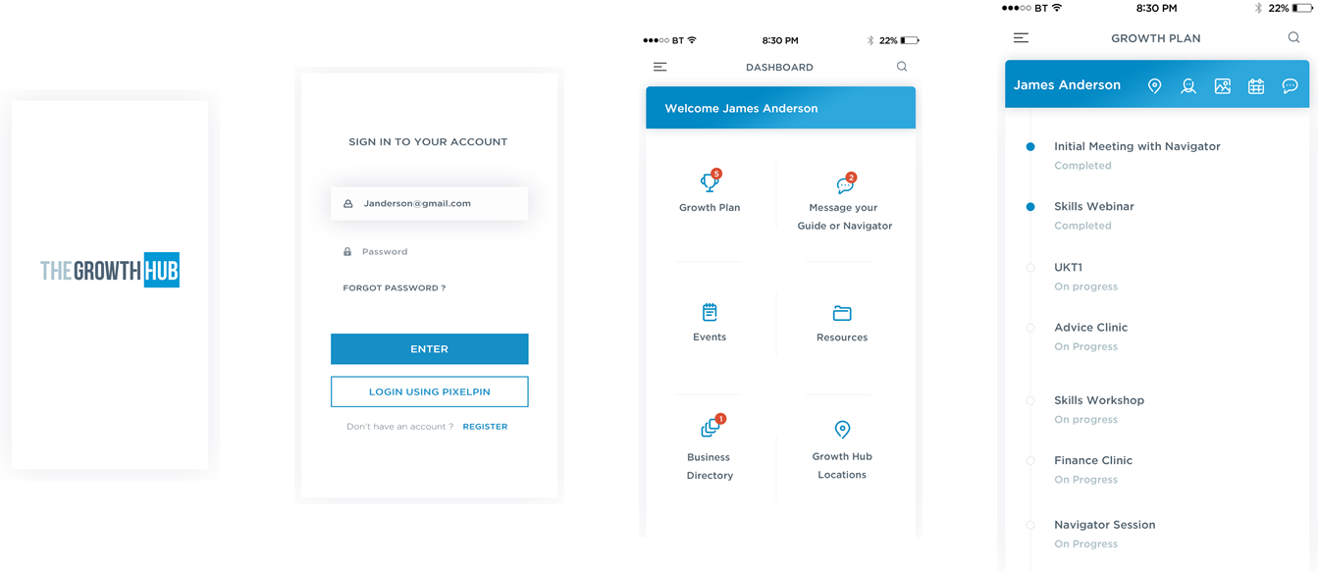
Growth Plan in my pocket
*Initial concept designs

Slide 8
Core Benefits for the Growth Hub
Increase engagement of clients with Growth Hub services.
Increase client experience by connecting online and physical Growth Hubs through the showcasing of how businesses can adopt technology to deliver similar experience.
Nurture and invigorate Gloucestershire business networking, creating demand to be a part of the Growth Hub community.
Create a template for other Growth Hubs, nationally, to white-label and to expand the breadth of the Business Directory.

Slide 9
"People will be much more likely to reach for their phones to facilitate physical / digital interactions to enhance or extend experiences through mobile.
Tom Grinstead (The Guardian)…and again!
This chap has a way with words!

Slide 10
Enhancing experiences
Streamlined Access – the application will be designed to communicate with bluetooth beacons to know when a client has arrived at a Growth Hub location and potentially provide seamless access to that location using the application on the smartphone.
When you visit a GH site – the application, by knowing that a client has arrived, could automatically inform their Navigator or Guide of their presence
Automatic wi-fi access - once a client has connected their Growth Hub account to their application, it will automatically log them onto the wi-fi network, no matter which Growth Hub site they are in, and allow us to monitor usage and potentially monetise the service.

Slide 11
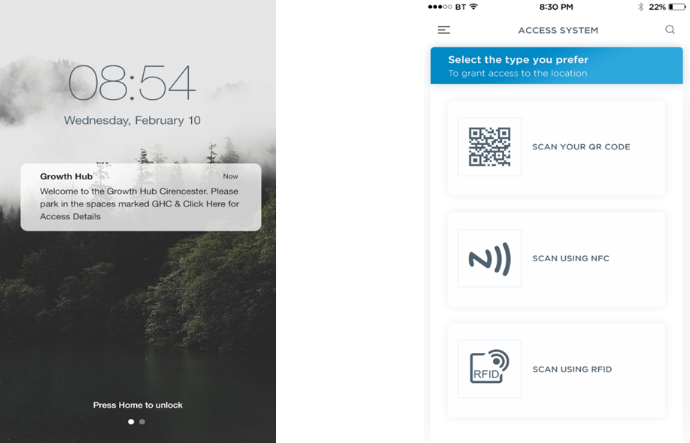
Enhancing experiences
*Initial concept designs

Slide 12
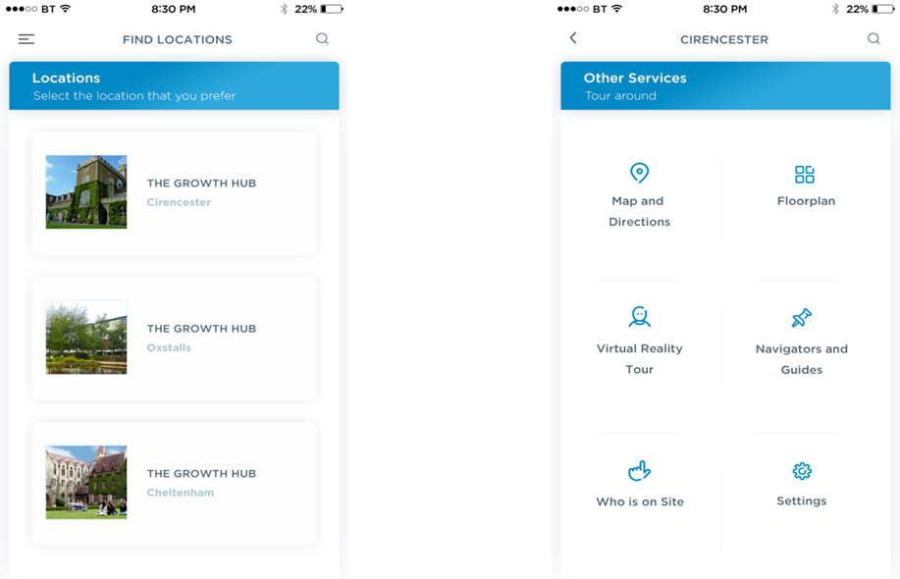
Enhancing experiences
*Initial concept designs

Slide 13
Development & Maintenance Costs
Activity | Year 1 | Year 2 | Year 3 | Year 4 | Year 5 | Total
Development | £140,000 |  |  |  |  | £140,000
Maintenance |  | £10,000 | £10,000 | £10,000 | £10,000 | £40,000
Wi-Fi access control | £3,000 | £10,000 | £5,000 |  |  | £18,000
Beacons | £1,000 |  |  | £1,000 |  | £2,000
Total | £144,000 | £20,000 | £15,000 | £11,000 | £10,000 | £200,000
*Estimated costs

Slide 14
Foundations for the future
A true digital business networking tool – The Growth Hub Business Directory
Is there appetite for this type of application?
Businesses and its employees have shown that communication and information are the key elements in business.
LinkedIn is a prime example of the business to business, colleague to colleague communication platform which is used in over 200 countries
Average CEO has 930 connections
But LinkedIn is for the individual – 60% of UK student & working population used LinkedIn – not the business
The Growth Hub Business Directory, would empower business owners and leaders to find businesses relevant to their needs for growth, and maybe even improve the procurement process at the same time.

Slide 15
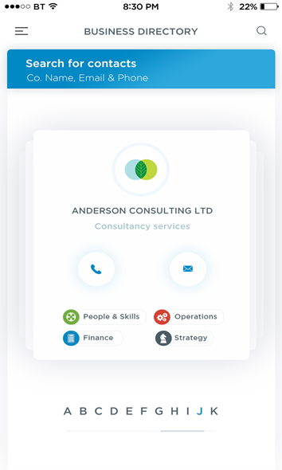
Business Directory
*Initial concept designs

